Slide 1
Estimation of Actuation Configuration for a Multi-Actuated Blimp
Final Presentation (Semester Thesis)
Students: Matthias Krebs Advisors: Kostas Alexis
Simon Laube Markus Achtelik

Slide 2
Content
System Overview
Problem Formulation
Parameters
System Model
Input Pattern
Optimization
Results
Simulation Results
Experimental Results
Ground Truth
Conclusion & Outlook

Slide 3
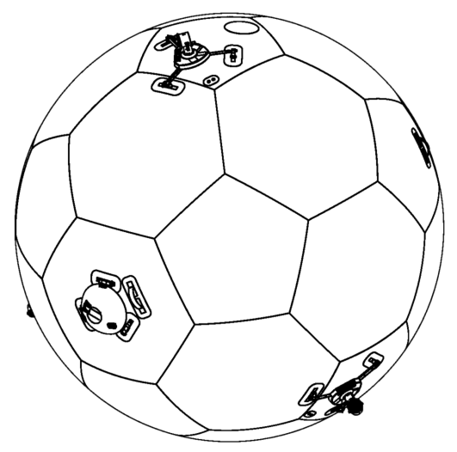
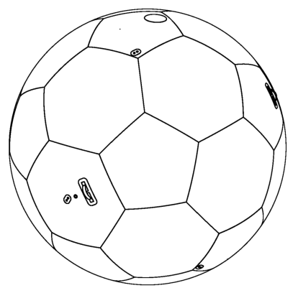
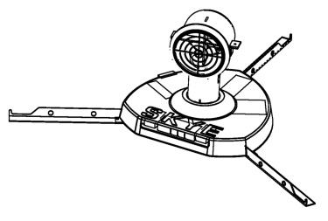
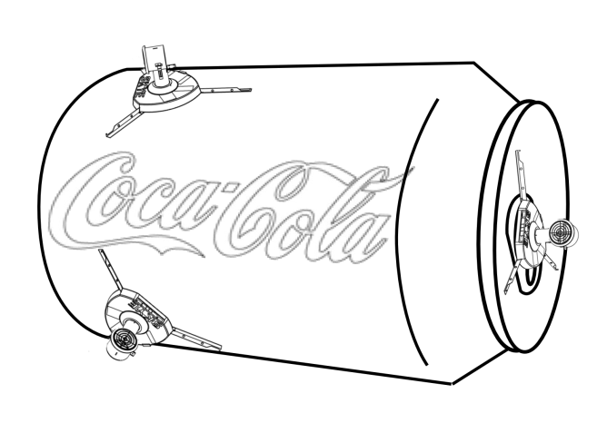
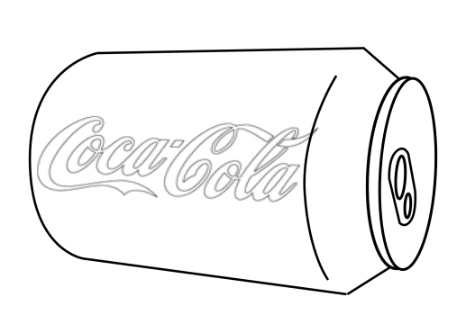
Motivation: Control Arbitrary Blimp
Parameter Identification
Arbitrary Blimp Hulls
Skye Actuation Unit
Elegant Movement

Slide 4
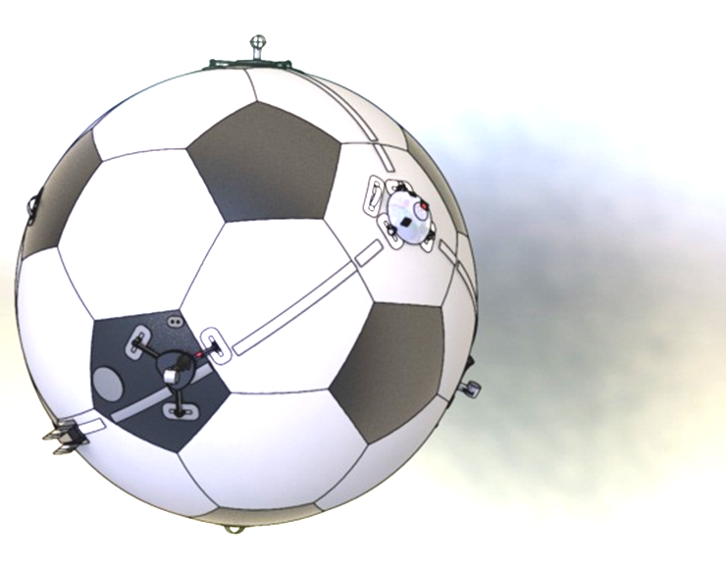
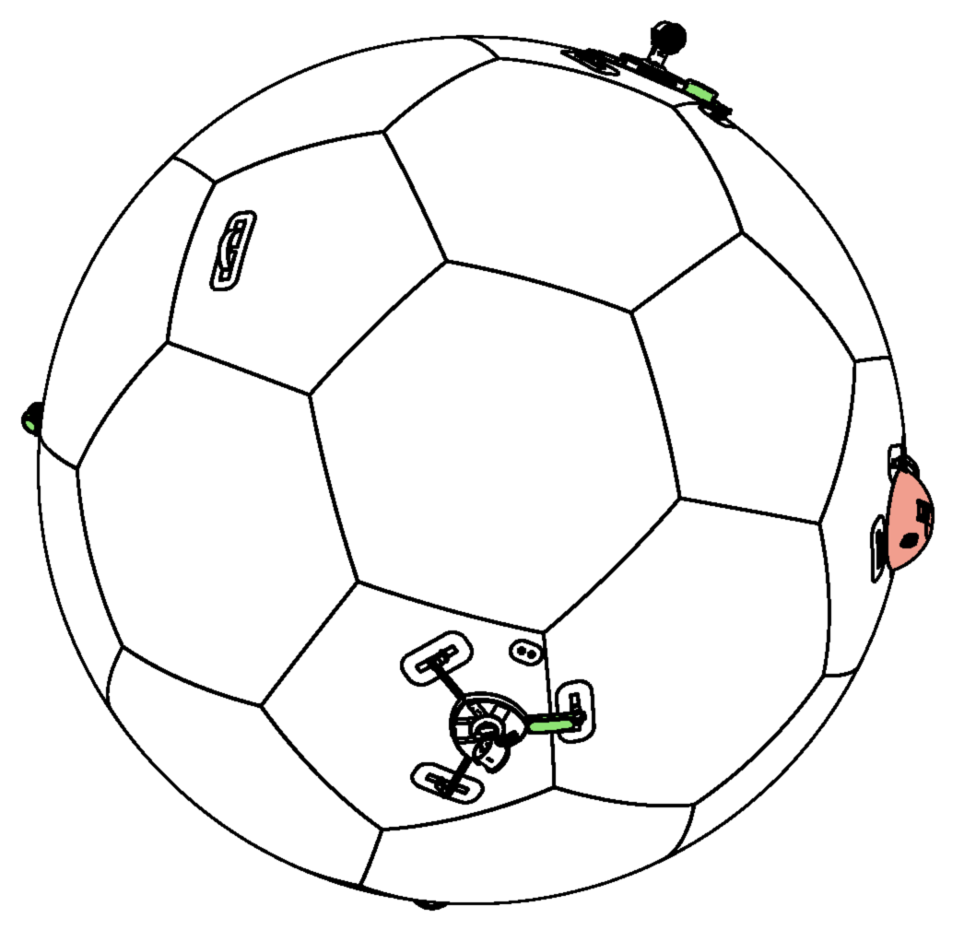
Motivation: Improve Usability & Control
taring weights
Controller
Hard to measure
Change payload
J cog
C_{bm}
Arbitrary Blimp Hulls
Help with system taring
Determine hard to measure parameters

Slide 5
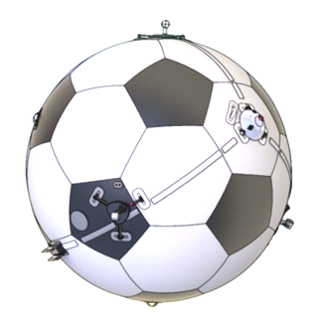
Problem Formulation
IMU Data
Actuator Input Pattern .
Parameter
Optimization Algorithm
System Model
Model Output

Slide 6
Problem Formulation
IMU Data
Actuator Input Pattern .
Parameter
Optimization Algorithm
System Model
Model Output

Slide 7
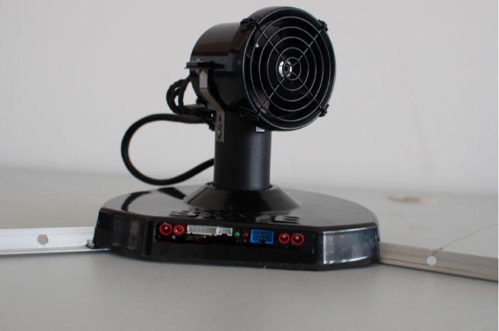
Problem Formulation: System
Spherical Hull filled with Helium
4 Actuation Units (AU)
Electronics:
IMU
Controller
XBee
Rotation
Thrust

Slide 8
Problem Formulation: System Control
Independent of Actuators
Depends on Actuators

Slide 9
Problem Formulation
IMU Data
Actuator Input Pattern .
Parameter
Optimization Algorithm
System Model
Model Output

Slide 10
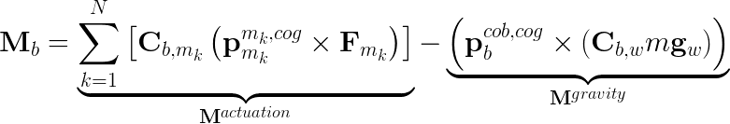
Problem Formulation: System Model
Angular Acceleration
with
Aerodynamic effects on rotation neglected (M^{aero} << M^{actuation})
Notes:
Halbwertszeit der Rotation ist ca. 50 sec

Slide 11
Problem Formulation
IMU Data
Actuator Input Pattern .
Parameter
Optimization Algorithm
System Model
Model Output

Slide 12
Problem Formulation: Parameters
Actuator Arrangement
Actuator Arrangement
Actuator Arrangement
Actuator Arrangement
Orientation SO(3)
Center of Gravity R³
Mass R
Position R³
Inertia Tensor Sym(3)
Radius
R
Full Parameter set is only jointly observable

Slide 13
Problem Formulation: Parameters
Actuator Arrangement
Actuator Arrangement
Actuator Arrangement
Actuator Arrangement
Orientation SO(3)
Center of Gravity R³
Mass R
Position R³
Inertia Tensor Sym(3)
Radius
R
Position is assumed to be on sphere
Radius and mass are assumed to be known

Slide 14
Problem Formulation: System Model
Angular Acceleration
with

Slide 15
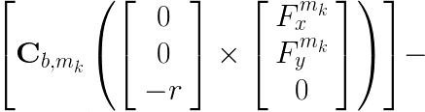
Problem Formulation: System Model
Parameter
Angular Acceleration
Constant (known)
State (known)

Slide 16
Problem Formulation
IMU Data
Actuator Input Pattern .
Parameter
Optimization Algorithm
System Model
Model Output

Slide 17
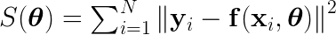
Problem Formulation: Optimization
Nonlinear Least Squares
Levenberg-Marquardt
Gradient based minimization
Robust and fast convergence

Slide 18
Problem Formulation
IMU Data
Actuator Input Pattern .
Parameter
Optimization Algorithm
System Model
Model Output

Slide 19
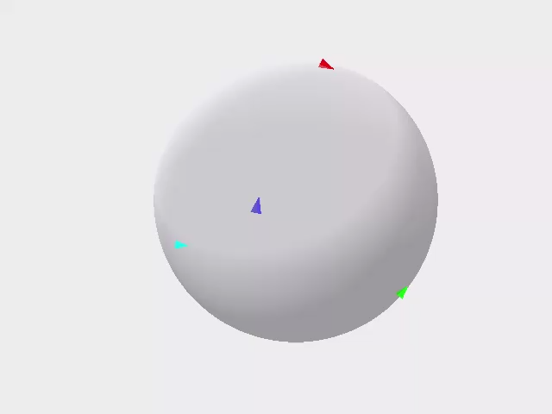
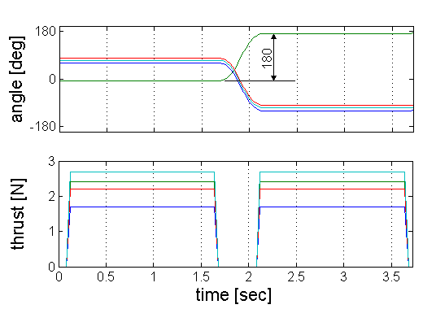
Problem Formulation: Input Pattern
Inputs must be applicable and sufficiently excited
Forward/backward
Varying directions
Steady state motor dynamics

Slide 20
Results
Simulation Results
Confidence Region
Convergence Region
Casestudies
Experimental Results
Comparison with Simulation
Groundtruth with Leica

Slide 21
Simulator
Object oriented simulator in Matlab
Modular concept for (almost) arbitrary blimps
Assembly
parts, Hamiltonians, …
Simplified view
Skye
Part
mass, inertia, dimension, c_{w}, …
Hull
AU
Eye
AU
AU
AU
IMU
…
Actuator
States, active forces …
Batt
Rot
…
Simulator
Dataset

Slide 22
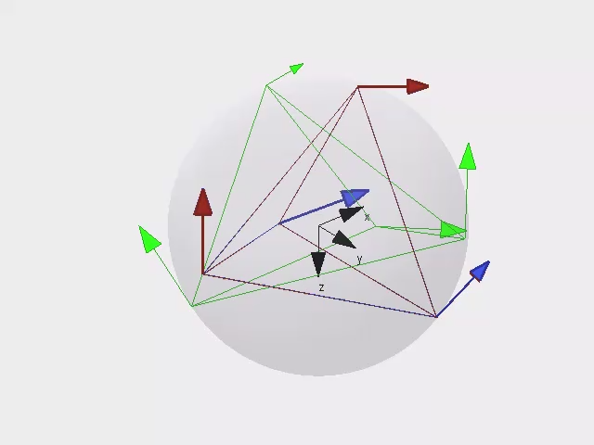
Results
x
α
y
6 LMA Iterations
Init
True
Batch

Slide 23
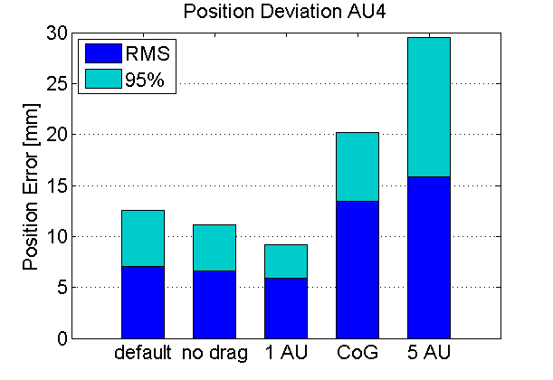
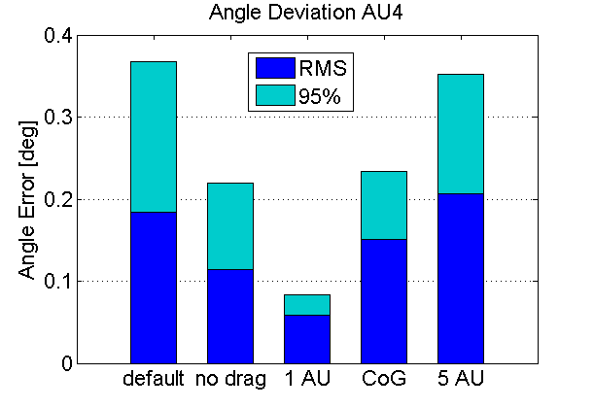
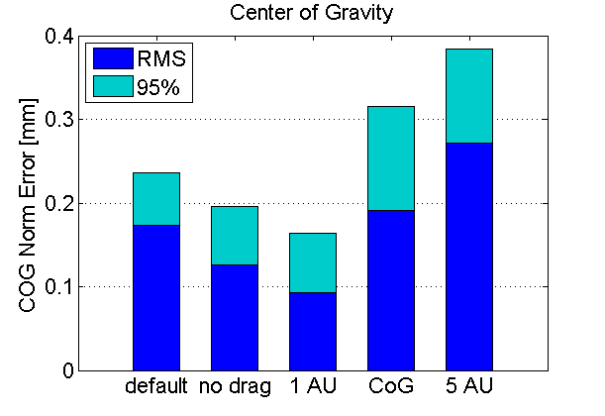
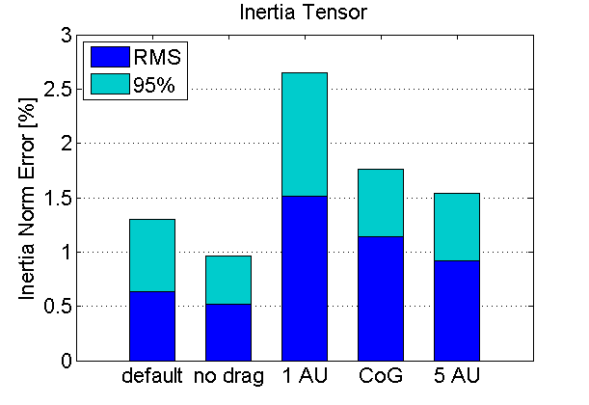
Simulation: Casestudies
16 simulations à 1000 datapoints

Slide 24
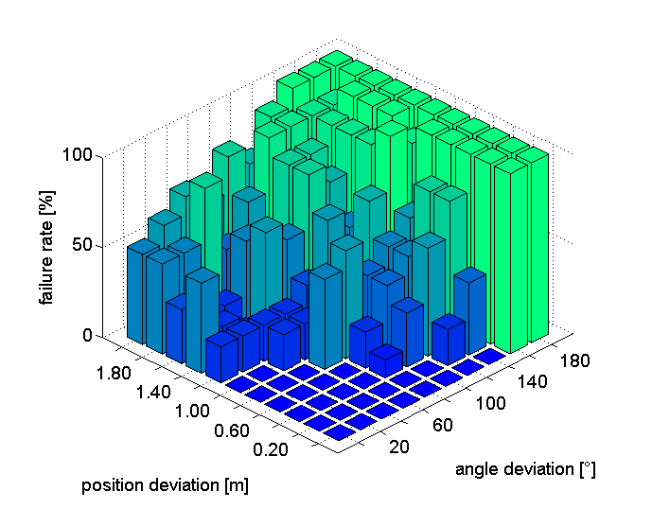
Simulation: Convergence Region
Initial Parameters can be about 1m or 120° apart of the true value

Slide 25
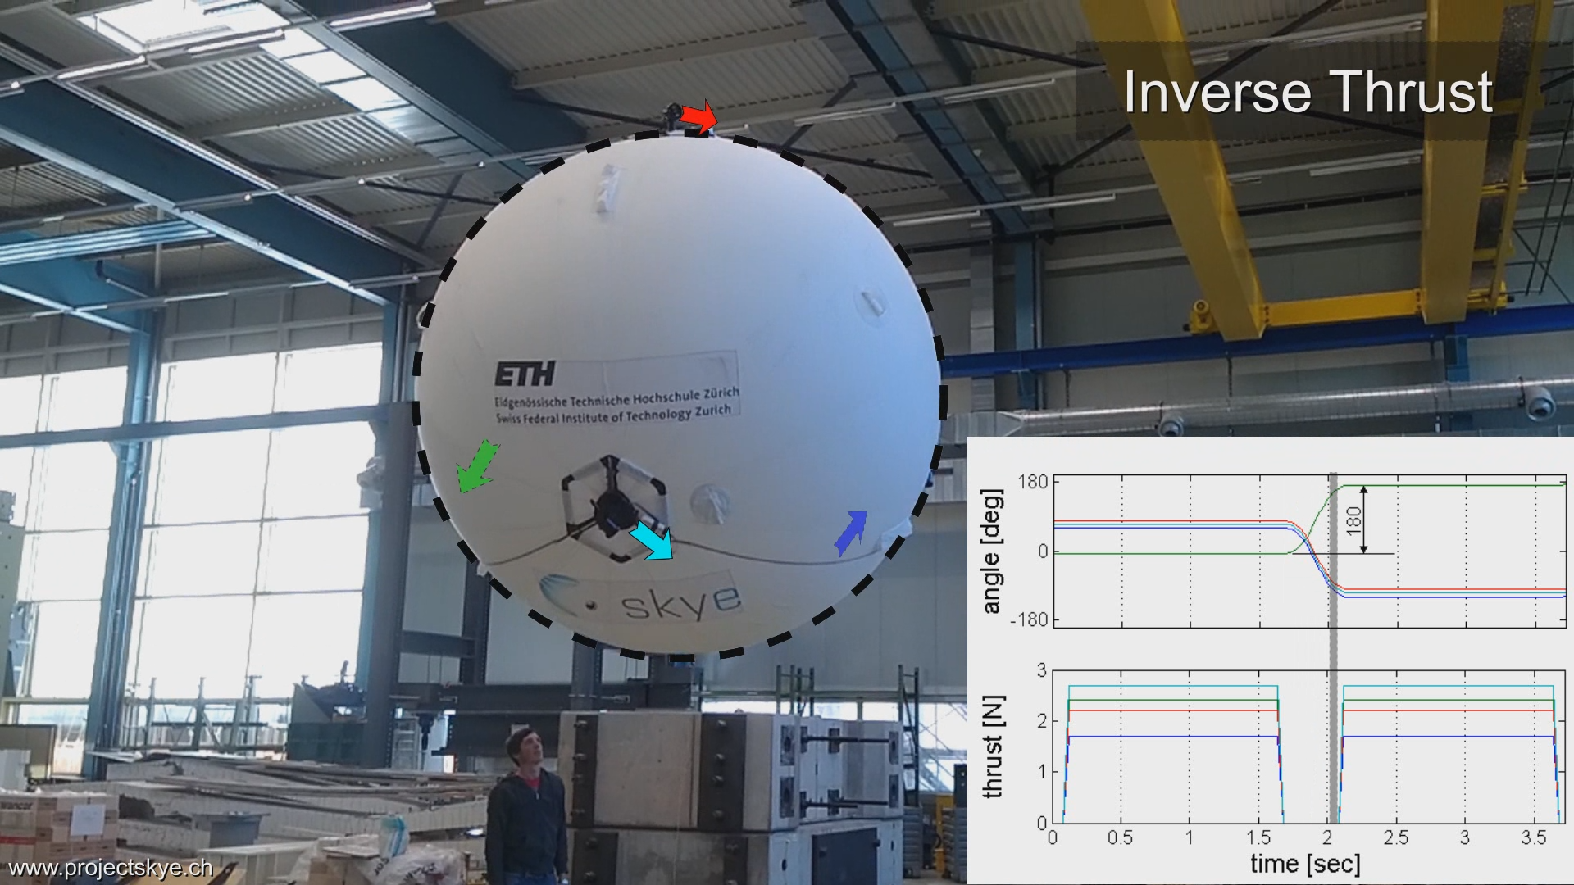

Data Acquisition

Slide 26
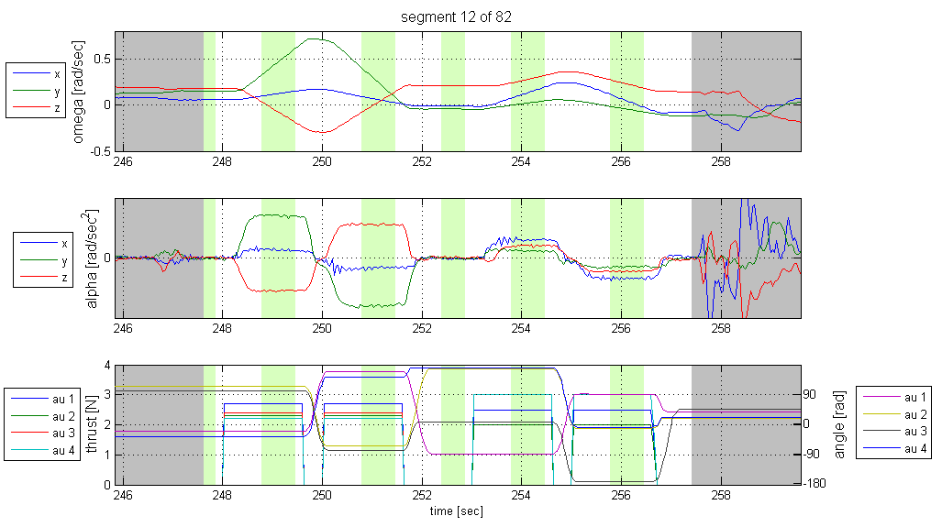
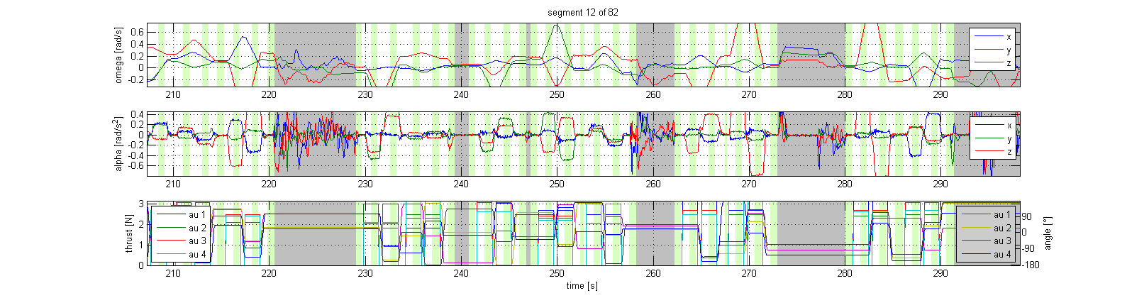
Data Acquisition
Disturbance:
Skye has been catched

Slide 27
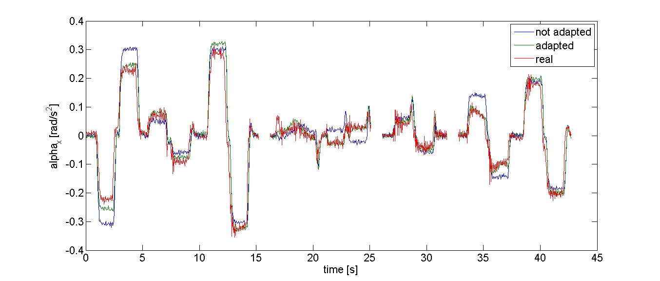
Results: Real Data vs. Simulation Data

Slide 28
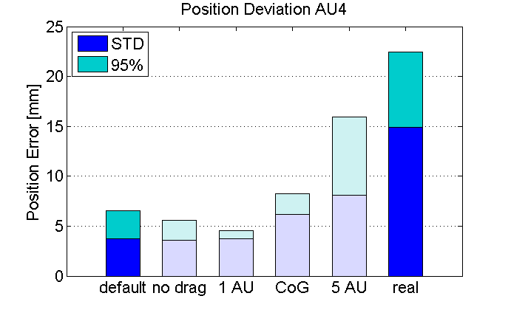
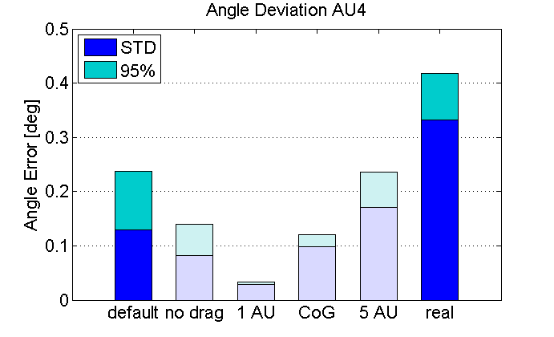
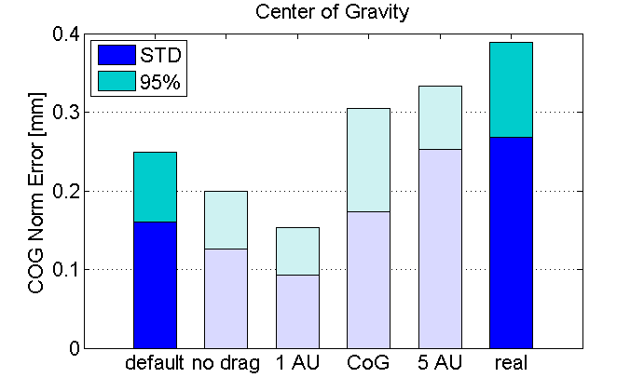
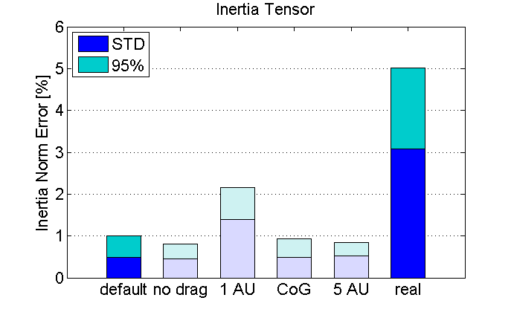
Results: Real Data vs. Simulation Data
16 simulations à 1000 datapoints

Slide 29
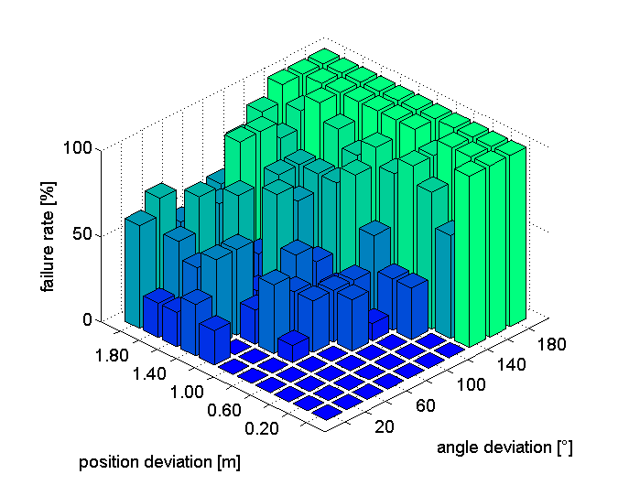
Experiment: Convergence Region
Very similar to simulation data.

Slide 30
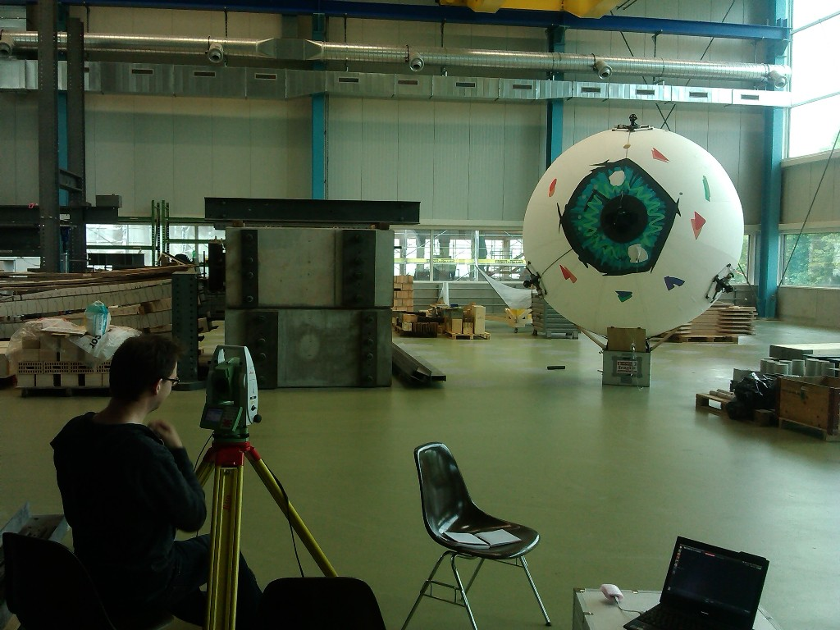
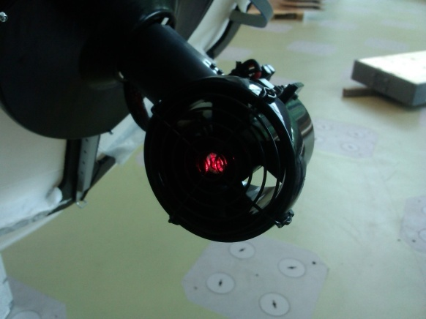
Results: „Ground Truth“ (Leica)
3 AU‘s visible at once
Use different views
Fit data to get tetrahedral‘s edge length
Residual below 0.01m

Slide 31
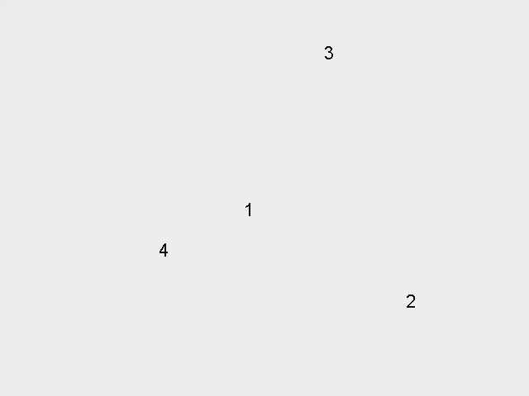
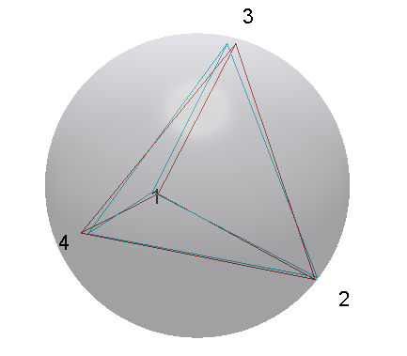
Results: Compare Leica and Batch Solution
Relative tetrahedral edge length error
% | AU2 | AU3 | AU4
AU1 | 1.68 | 0.86 | 2.76
AU2 |  | 0.67 | 2.47
AU3 |  |  | 3.78
Leica
Batch

Slide 32
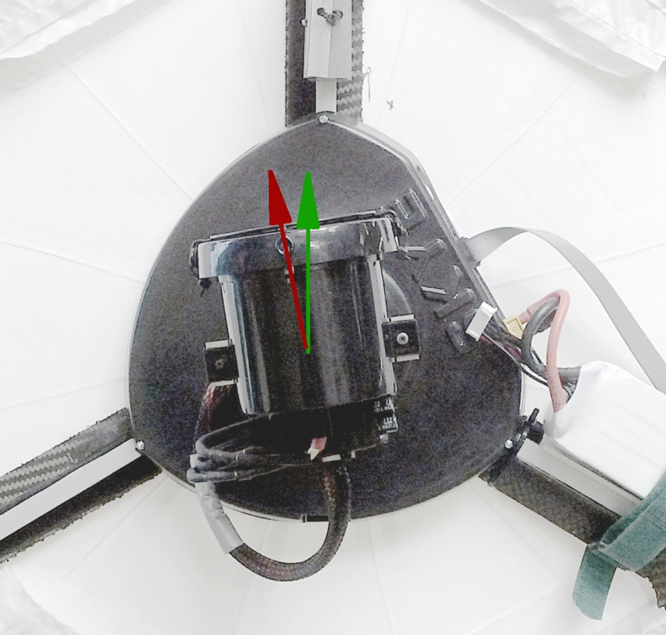
…
assumed
batch sol.

Slide 33
Conclusion
What did we do?
Showed applicable method to estimate actuator configuration
How accurate?
Actuator positions can be estimated within centimeters
Where to use?
Automatically update parameters before flight within minutes

Slide 34
Thanks

